Slide 1
XXXX Sail and Power Squadron
Boating is fun…we’ll show you how®

Slide 2
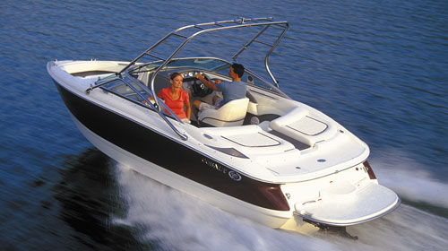
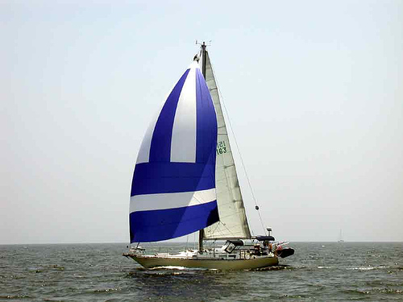
XXXX Sail and Power Squadron
United States Power Squadrons (USPS)
  39,000 members
  Promotes boating knowledge, safety, and fun
You’ve come to the right place !!!!

Slide 3
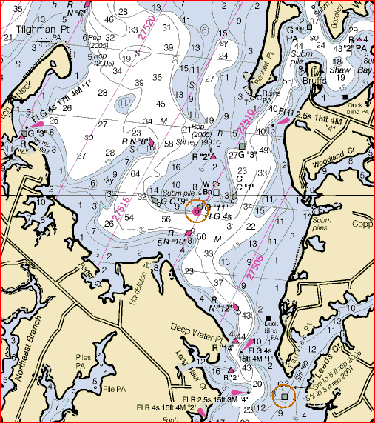
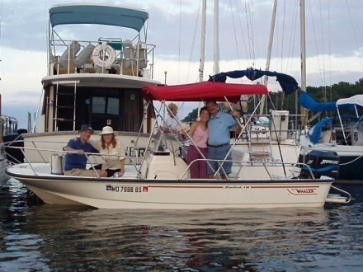
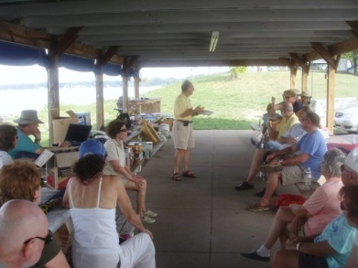
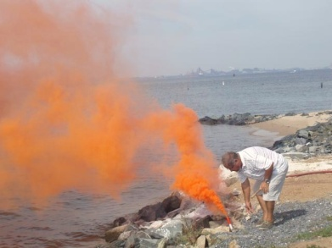
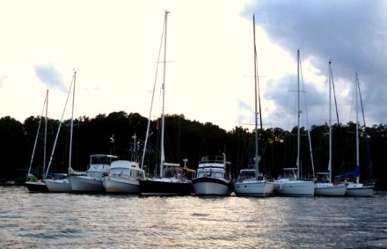
XXXX Sail and Power Squadron
We have a wide variety of activities
  Many courses & seminars
  Boating events
  Monthly dinner meetings with speaker
  Safety training & vessel safety checks
  Active in the boating community

Slide 4
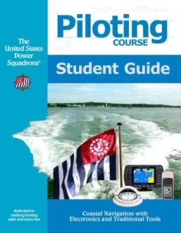
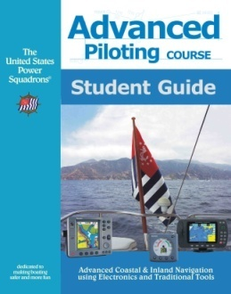
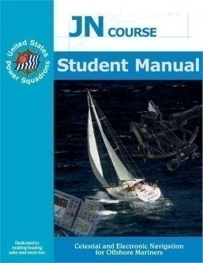
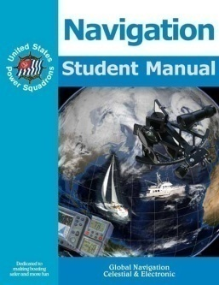
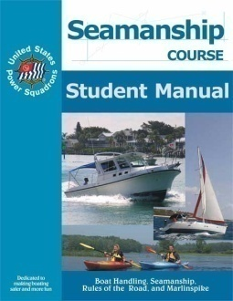
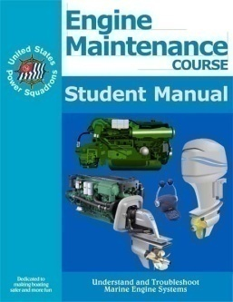
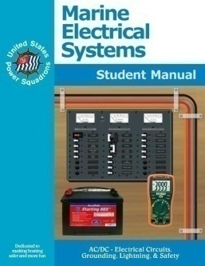
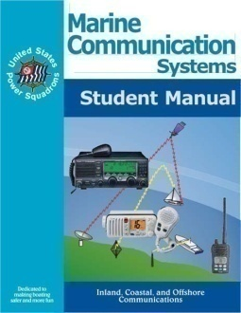
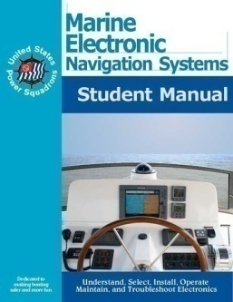


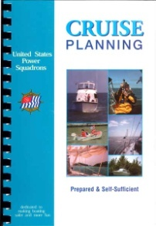
Courses
Navigation
  Inland and Coastal
  Offshore
Seamanship
Marine Equipment
Weather
Sail
Cruise Planning
On the water training!!!
Notes:
Take a look at our course offerings…..
You pay for materials. only This is a deal!!!
The State of (insert your state’s name here) regulatory and insurance
landscape is changing. We’ve always had to be licensed to drive our vehicles
as well as have insurance and registration for our cars. But now,
we have to have the same for our boats as well. (Or if you live in a state that does
not require registration—make the statement that these requirements are or are
scheduled to come before the legislature for consideration and it’s just a matter
of time).
You have the opportunity to learn more while enjoying your boat.. Check our these course offerings.

Slide 5
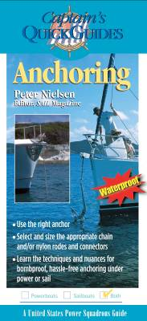
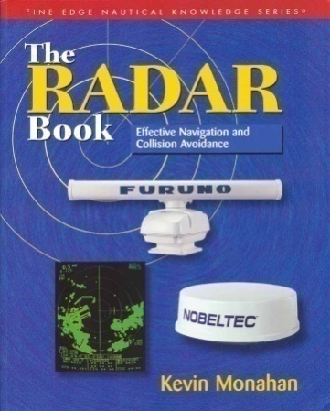
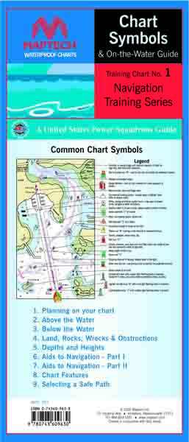
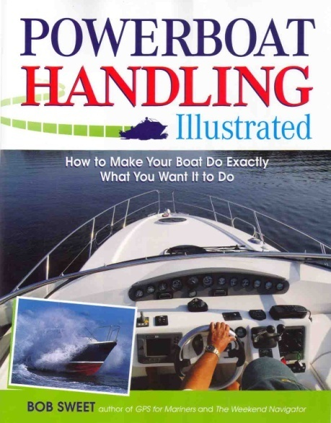
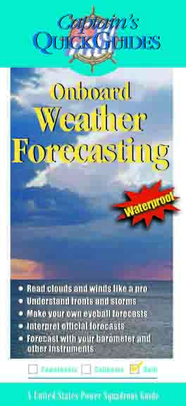
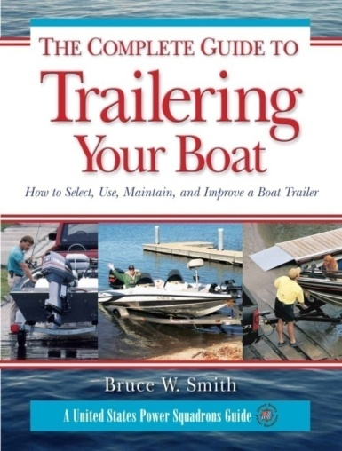
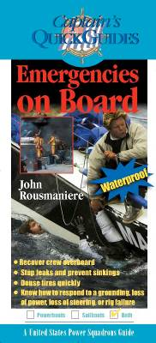
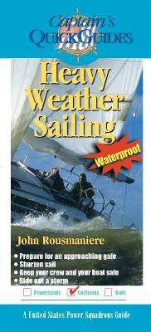
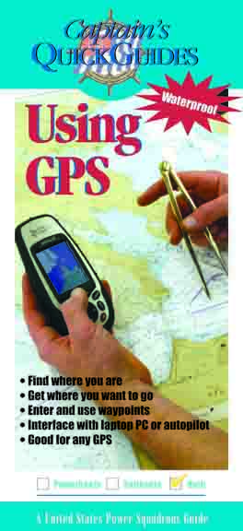

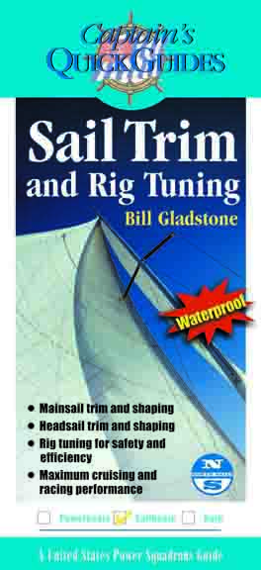
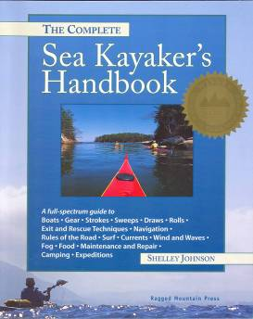
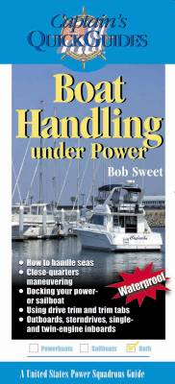
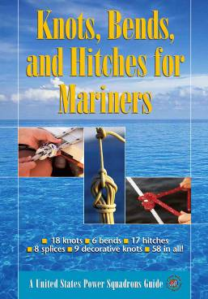
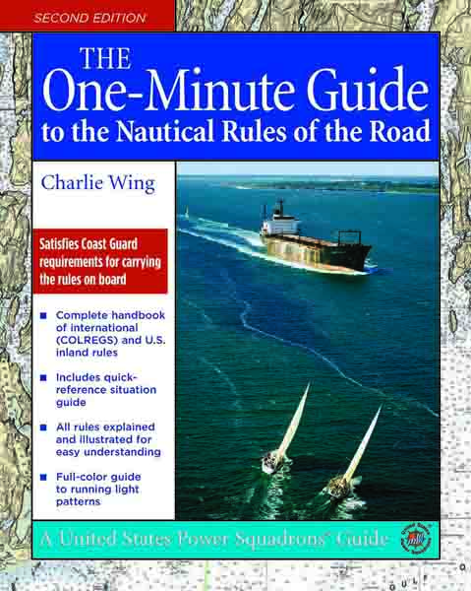

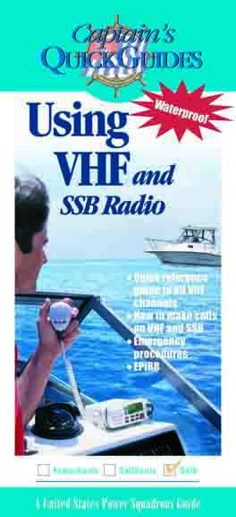
Two Hour Seminars
Notes:
We know that our State (insert name) requires certification to operate your boat. The
United States Power Squadrons offers you the easiest way to gain that
certification while building your skills and knowledge of boating. And, as a big
plus, most insurance companies will offer you a discount on your premiums
when they see you have your Certificate Of Completion which you’ll get when you
successfully complete this course.

Slide 6
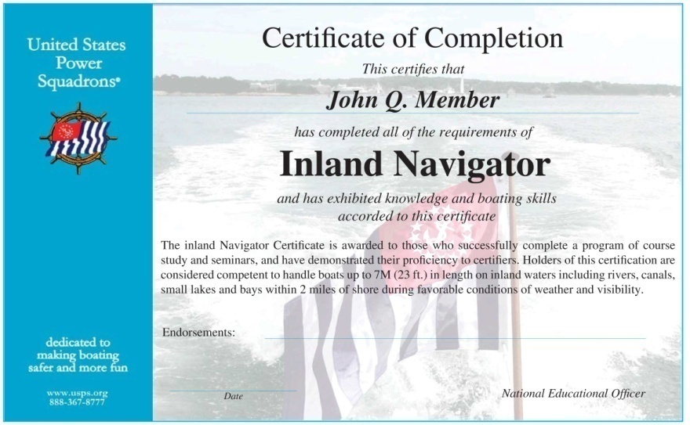
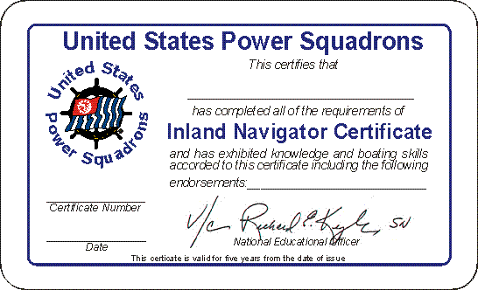
Boat Operator Certification
Recognized Credentials
  Inland
  Coastal
  Advanced Coastal
  Offshore
Seminars
  Credit toward certification

Slide 7





Savings on Insurance and Boating Products
Insurers offer greater savings to those who take member courses
  Save as much as 23% on insurance premiums
  Among others
Notes:
Discounts in insurance and other reduced cost benefits are available to you.
The more courses you take, the more you know and your insurance costs will be lowered.
Check out our online registration site.

Slide 8







Savings on Insurance and Boating Products
  Charts and Marine Books
  Boating Equipment
  Software
  Computers
  Insurance
  Literature and Courseware
  Publications
Notes:
Check out these member benefits!
The more courses you complete the greater insurance discounts you will receive.

Slide 9
XXXX Sail and Power Squadron
Come for the Education,
Stay for the Friends!!!
To Join: membership@xxxx.org
Seminars & Courses: seo@xxxx.org
Website: www.xxxx.org
Boating is fun…we’ll show you how®
Notes:
We have decades of experience with the recreational boating community helping
us all get more enjoyment from our boating experience. As we move through our
(name the course/seminar) I’m going to show you how I benefitted from the
knowledge I gained that’s not a part of the course material. Members of
the United States Power Squadrons took an interest in me not only as a student,
but as a friend. They helped me understand parts of (name this course/seminar)
that I might have missed.
AND AS A MEMBER OF THE UNITED STATES POWER SQUADRONS I’D LIKE TO
SHARE THAT SAME EXPERIENCE WITH YOU; NOT AS A STUDENT, BUT AS A
MEMBER.
BOATING REALLY IS FUN…AND AS A MEMBER YOU’LL HAVE EVEN MORE FUN!
DOES EVERYONE HAVE THEIR NAMETAG? LET’S GET STARTED!!!!!
JOIN US AND BENEFIT FROM MEMBERSHIP IN USPS!

Slide 10

XXXX Sail and Power Squadron
Boating is fun…we’ll show you how®

